Slide 1
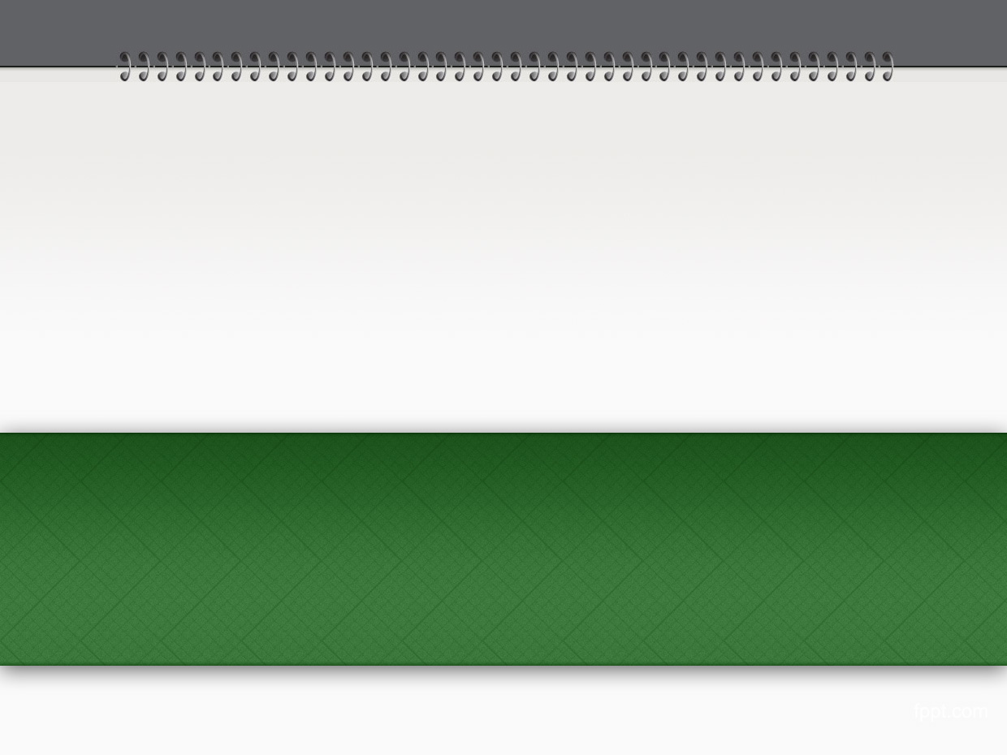
Chapter 6-7: Views and Controllers
Summary from book “Beginning Rails 3 - Cloves Carneiro Jr_”

Slide 2
Sample code
Repo: git@github.com:pingovn/pingo-rails-basic.git
Branch: chapter 6 & chapter 7

Slide 3
Overview
At end of this chapter, you could
  Implement controllers following RESTful model
  Implement routing (resource..)
  Implement views by template
  Implement helpers
  Embed javascript to application

Slide 4
MVC model
MVC = Model-View-Controller
Models are responsible for database related actions
Controllers are responsible for handling the request and issuing a response
Views are responsible for rendering the output of a response in a way a browser (or any other user agent) can understand

Slide 5
Helper
Although most of codes are in Models, Views & Controllers, there is a “helper” that supports VIEWS
Helpers supports views to DRY by using same method & executed by views
Ex: you have a helper to show out an “avatar” in profile view. But you also have it shown in comments. So, you could create a helper to manage avatar rendering. When you change it, it affects to all views.

Slide 6
Embedded Ruby
ERB = Embedded Ruby
It is a code that Ruby is mixed into HTML. This works as same as ASP (HTML + C#/VB), JSP(HTML + Java) or PHP (HTML + PHP)
Embedding tags:
  <% … %>
  <%= …. %>

Slide 7
Routing
The routing system allows you to write the rules that govern how each URL is picked apart and handled.
Ex: http://localhost:3000/articles/1
  Routine system will “analyze” above URL. It passes “1” to “Article” controller
A good routing will make user-friendly URLs, easy to remember & meanningful.

Slide 8
RESTful
REST = Representational State Transfer
It is a principle to offer a better interface for client-server.
Request methods: POST, GET, PUT, DELETE. These request methods could be mapped to CRUD as below
    POST = CREAT = create a resource
    GET = READ = request a resource info
    PUT = UPDATE = edit attribute of resource
    DELETE = DELETE = delete a resource

Slide 9
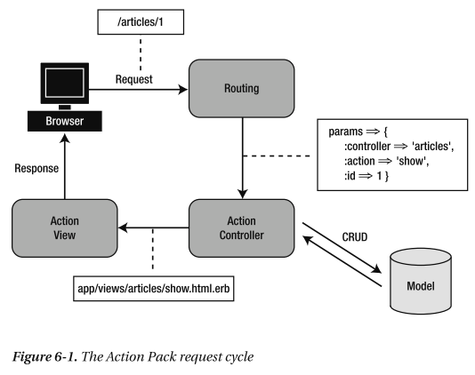
A request cycle
Client makes a request via URL (ex: /articles/1)
The request goes to Routing system. It was parsed, and Rails call suitable controller to handle the request (ex: controller=‘articles’, action=‘show’, id=‘1’).
Action controller (articles) access to database to get item (with id=1)
Rails executes “show” method.
After this method done, action view renders “show.html.erb” & send back client

Slide 10
Route
Rails has a config file to define routing
Route setup
  match '/teams/search/:query' => 'teams#search', :as => 'search‘
    ‘teams’ → controller
    ‘search’ → method
    ‘query’ → parameter passed to method
    ‘search’ → named route

Slide 11
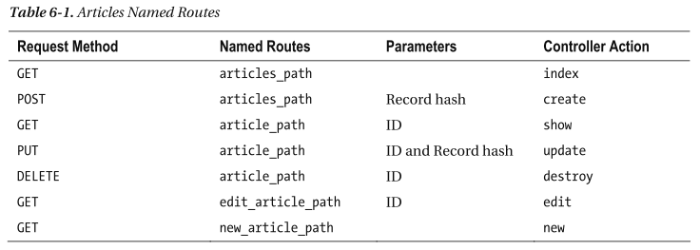
Route for RESTful
By using a named route, Rails create routing helpers automatically.
new : show form
create : update database for “new” form
edit : show form
update : update database for “edit” form

Slide 12
Route for application
config/routes.rb
  Blog::Application.routes.draw do
  root :to => "articles#index"
  resources :articles
  end
  root : default url (http://localhost:3000)
  resource : route for RESTful url (index,
  show, new, edit, create, update, and destroy)
  Use “rake routes” to show all valid routes

Slide 13
Redirecting
Redirect is the case that server returns a redirect response to client to tell it perform a redirection to another URL.
Redirect is done at client side (not server side). If your controller contains multiple “render” & “redirect”, it causes error because method returns response at end of methods so that multiple redirection. In the case of it, use “return”. Ex:
  render “my_view” and return if <<condition>>
  ….
  redirect_to <<another url>>

Slide 14
Layout
Layout is used to organize an html page
By default, application layout is used for lal pages app/views/layouts/application.html.erb
  Listing 6-6. The app/views/layouts/application.html.erb File
  <!DOCTYPE html>
  <html>
  <head>
  <title>Blog</title>
  <%= stylesheet_link_tag :all %> → embed stylesheet
  <%= javascript_include_tag :defaults %> → embed javascript
  <%= csrf_meta_tag %>
  </head>
  <body>
  <%= yield %> → “render” content will be put here
  </body>
  </html>

Slide 15
Loading layout
By default, a controller will load specific layout if exists. Ex: you have layouts/comment.html.erb, it will be loaded for comment controller.
If controller layout is not exist, it will load “application” layout
  app/views/layouts/application.html.erb
To change this default behavior, use “layout” in controller
  class ExampleController < ApplicationController
  layout 'my_layout’
  end
  It will load app/views/layouts/my_layout.html.erb
Use “render :layout => false” to select no layout for the view

Slide 16
Templates
Templates use controller method
  index.html.erb
  show.html.erb
When there is a template that is used more than 1 place, make it as a partial & load it from the places. It is DRY in views.
Include below code to add a partial to a view. We will learn more details partials in next slides
  <% render “form” %>

Slide 17
Create an article
“new” method is to show new form. “create” method is to save database
app/controllers/articles_controller.rb
  # POST /articles → reponse “html” (default)
  # POST /articles.xml → reponse “xml” format
  def create
  @article = Article.new(params[:article])
  respond_to do |format|
  if @article.save
  format.html { redirect_to(@article, :notice => 'Article was successfully created.') }
  format.xml { render :xml => @article, :status => :created, :location => @article }
  else # error case
  format.html { render :action => "new" }
  format.xml { render :xml => @article.errors, :status => :unprocessable_entity }
  end
  end
  end
We get parameters sent by client via params variable. respond_to method selects suitable response format coresponding to each kind of request.

Slide 18
LAB 1
In this lab, we will test if the response is good in different kinds of format.
There is a Chrome plugin to allow sending request to server with specific data & format: https://chrome.google.com/webstore/detail/advanced-rest-client/hgmloofddffdnphfgcellkdfbfbjeloo
Use this plugin to connect to your server. Sending request in HTML, XML, JSON format & observer the responses.

Slide 19
LAB 2
We will implement views for controllers edit & update.
Request
  Edit: it is method to show out edit form
    Route: http://localhost:3000/articles/1/edit
    /views/articles/edit.html.erb
  Update: it is method to update database
    If html request, after update, redirect to saved article
    If xml request, reponse {status: ok}

Slide 20
Display error message
In previous chapter, we learned about validation. Validations check record data & return error in case of violation.
In view, we need to catch these errors & show it properly.
  <% if @article.errors.any? %>
  <div id="errorExplanation">
  <h2><%= pluralize(@article.errors.count, "error") %> errors </h2>
  <ul>
  <% @article.errors.full_messages.each do |msg| %>
  <li><%= msg %></li>
  <% end %>
  </ul>
  </div>
  <% end %>

Slide 21
Partials
Partial is a view that is rendered by other views. The purpose is to split the common parts of views to separated views for DRY.
app/views/articles/new.html.erb
<h1>New article</h1>
<%= render 'form' %>
<%= link_to 'Back', articles_path %>
app/views/users/edit.html.erb
<h1>Editing article</h1>
<%= render 'form' %>
<%= link_to 'Show', @article %> |
<%= link_to 'Back', articles_path %>
We have a form the is used by “new” & “edit” views.
That is a good use of partial. Partial has “_” as filename prefix.
By above example, filename is _form.html.erb

Slide 22
Partials
Partial allows local “variables” that are passed from “render”. Ex:
  <%= render 'article', :article => @article %>
  By passing parameters to render method, a “article” variable was created. You could use this variable inside _article.html.erb.
Instead of using a string in render to specify partial view, if you use a collection, Rails will render each item one by one. It means that
<%= render @articles %>
Rails will automatically render all items in the collection, each item was passed to /app/views/articles/_article.html.erb

Slide 23
LAB 3
Review all views to realize if there is any COMMON parts.
Common parts might be
  Some data processing → helper
  Render something → partial

Slide 24
Summary
We have learned
  Implementation of routing system via routes.rb
  How to handle different formats from clients such as HTML, XML or JSON
  How to use a common layout or a specific layout for a controller
  We created some views via templates. If the view contains common part, we will use partials
  We also create helper that are methods shared between controllers & views. So, we knew some tools to keep DRY for controllers (by callbacks or shared methods), for models (by callbacks or shared methods), for views (by partials), and for different controllers/views (by helpers)

Slide 25
LAB 4
Review the different between this branch & next chapter branch. Every single change should be asked to mentor !

